Slide 1
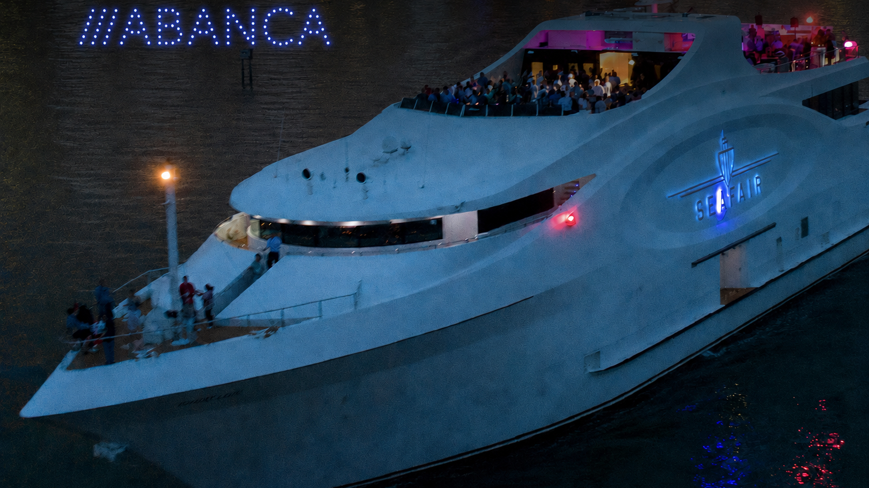

DRONE LIGHT SHOW AT SEAFAIR
100 synchronized drones • October 16
SeaFair Miami Grand Luxe • 100 Chopin Plaza
Prepared for GrupoSky • Attn: Sofía de la Torre

Slide 2
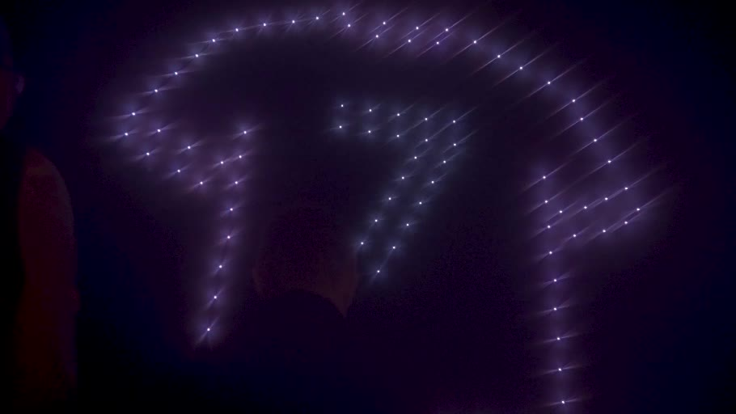
100-DRONE SHOW — BOSS

Slide 3
DRONE SHOW OPTIONS
Choose the right scale for SeaFair
Both packages include creative production, regulatory coordination and on-site setup.
INCLUDED IN BOTH OPTIONS
SIGNATURE PACKAGE
ENHANCED VISIBILITY
✓
Custom logo animation
100
150
DRONES
DRONES
✓
Music synchronization
✓
FAA authorization
$13,750
$20,250
✓
Miami airspace coordination
USD · client investment
USD · client investment
✓
Aviation insurance
Valid for 15 days
Valid for 15 days
50% retainer
50% retainer
✓
On-site setup
Balance due 10 business days before event
Subject to venue, airspace, FAA, site-safety and weather approval.

Slide 4
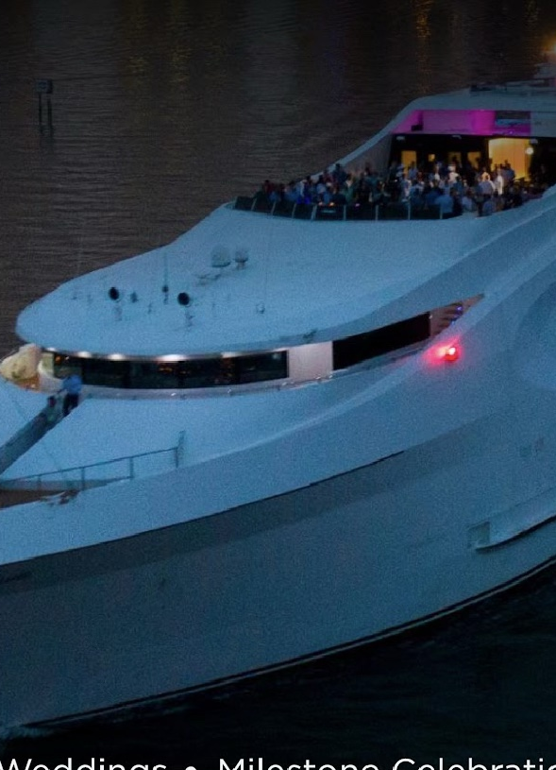
NEXT STEP
Confirm the 100-drone package
and begin the SeaFair site review.
The operating team will confirm launch area, viewing direction, airspace and safety requirements before final production.
Ignacio Irazoqui
POP Graphics • Miami, Florida
Phone / WhatsApp: (305) 244-0918
popgraphics.us

